Slide 1
Methods and Concepts for Efficient Verification of UML/OCL Models
Asadullah Shaikh
asshaikh@nu.edu.sa
November 13, 2013

Slide 2
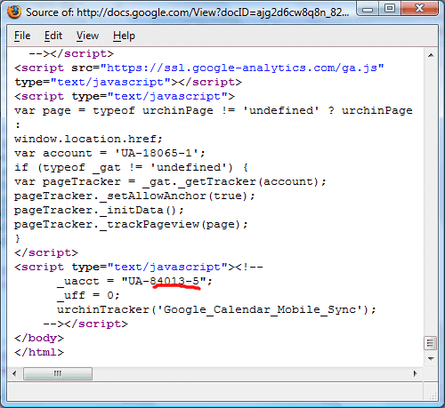
Software Development Life Cycle
Introduction
UML/OCL Class Models
Problem
Requirements
Development
Maintenance
Notes:
Primary development artifact developers are using models instead of writing code.

Slide 3
Verification
Introduction
Verification is essential at earlier stages
Defect correction cost
Software life cycle
“Our Research is based on Verification Process of UML/OCL Class Models”
Notes:
Model defects are a significant concern in the model driven development paradigm as model transformation may propogate erros where they are detect and trace.

Slide 4
How UML/OCL Model Looks Like...
Introduction
Graphical constraints:
Multiplicities of associations
Inheritance hierarchies
context Person inv:
self.age ≥ 0
Textual constraints:
Complex class invariants

Slide 5
Class Model Verification
Introduction
Class
Satisfying Object
Unsatisfying Object
Person
name: string age:int
P1:Person
name = ‘Tony’ age = 23
P2:Person
name = ‘Tom’ age = -3
// Person’s age must be more then zero
context Person inv: self.age>0
Notes:
So in most of the tools the input diagram is UML/OCL models and output is either YES/ OR NO

Slide 6
INPUT & OUTPUT
Introduction

Slide 7
Identifying the Problem
Problem
Verification of large and complex UML/OCL model
Efficient technique for scalability
At certain point, available verification methods stop working
CPU time
Memory
Allocated resources

Slide 8
Example (Estimated time)
Problem
UMLtoCSP takes 92 second to verify the property.

Slide 9
Example (Estimated time)
Problem
New classes that do not affect the property being verified.
2 hours (did not verify any property)

Slide 10
Identifying V&V Tools
Problem
V&V Tools Available in Literature.
UMLtoCSP (Developed at GRES-UOC)
HOL-OCL
MOVA
ALLOY
UML2ALLOY
USE
CQC (Is method)
Other methods (not implemented)
Notes:
HIGH COMPUTATONAL COMPLEXITY and the lack of scalability

Slide 11
Comparison and Support of UML/OCL Tools
Problem
Notes:
To find out the verification time we first proposed the comparison of each tool so we can make and get the example of that types only

Slide 12
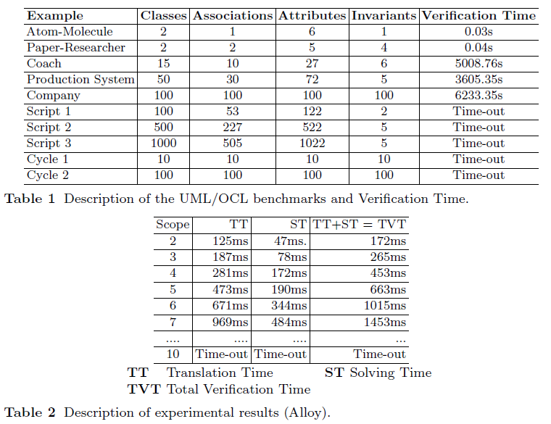
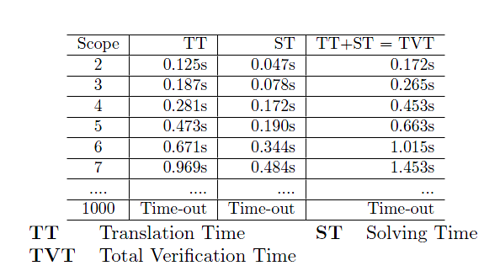
Efficiency Analysis
Problem

Slide 13
Research Objective
Objective
To design a Framework/Technique for improving the scalability for verification process
Efficient verification technique usable to large models
Abstract irrelevant components of the system
Partition model into independent submodels
Notes:
The first through came in our mind to develop a formalism with some abstraction techniques. But then we thought that particular foramlism will be only be used by our tool. Then we decided to come up with some slicing technique that should abstract irrelevant components of model and divide original model into submodels

Slide 14
Hypotheses
Objective
H1. Slicing will reduce the verification time
H2. Slicing will enable verification of more complex UML/OCL class diagrams
H3. Slicing can be implemented in existing verification tools independent of their formalism
Notes:
The slicing technique which we will develop must do H1, H2, H3.

Slide 15
UML/OCL Slicing Technique
Solution
Slicing a model into small fragments (submodels).
Our Defined Partitioning Technique
Verification Method

Slide 16
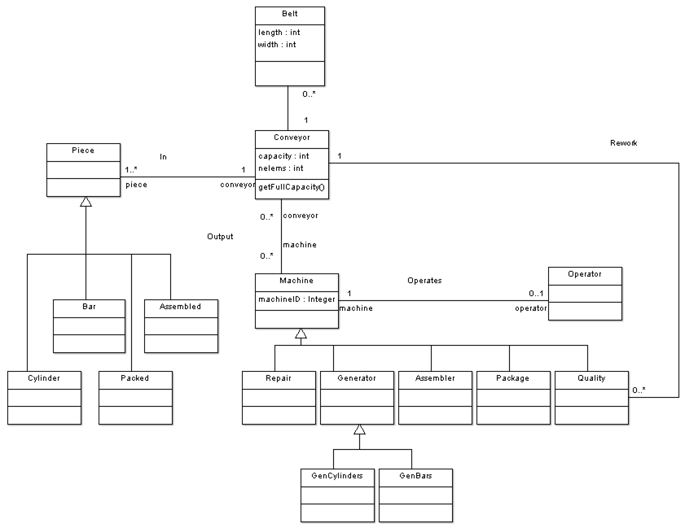
Production System
Solution
Notes:
16 classes, 16 links (5 associations and 11 inheritance hierarchies)

Slide 17
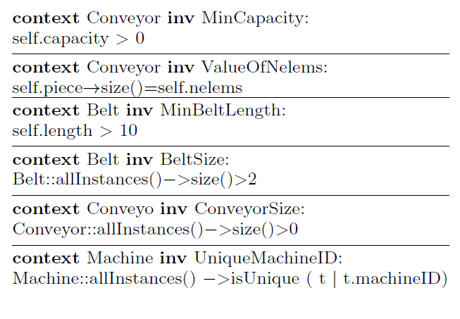
Production System
Solution
Notes:
16 classes, 16 links (5 associations and 11 inheritance hierarchies)
With 6 invariants

Slide 18
Two Slicing Criteria
Solution
Disjoint Slicing: considers disjoint set of submodels
Non-disjoint Slicing: considers non-disjoint set of submodels

Slide 19
Slicing (Cluster 1)
Solution
Invariants | Support
MinCapacity, ValueOfNelems, and ConveyorSize | Conveyor, Piece
MinCapacity
Invariants
ValueOfNelems
ConveyorSize
Notes:
With the help of the constrinat support we can see that we need conveyer and piece and the tightly coipled

Slide 20
Submodel 1
Solution
MinCapacity
Abstraction
Classes | Attributes | Reduction
13 | 2 | 87%
Invariants
ValueOfNelems
ConveyorSize
context Conveyor inv MinCapacity:
self.capacity > 0
context Conveyor inv ValueOfNelems:
self.piece->size()=self.nelems
context Conveyor inv ConveyorSize: Conveyor::allInstances()->size()>0
20

Slide 21
Slicing (Cluster 2)
Solution
Invariants | Support
MinBeltLength and BeltSize | Belt
MinBeltLength
Invariants
BeltSize

Slide 22
Submodel 2
Solution
MinBeltLength
Abstraction
Classes | Attributes | Reduction
12 | 3 | 80%
Invariants
BeltSize
context Belt inv BeltLength:
self.length>10
context Belt inv BeltSize:
Belt::allInstances()->size()>2
22

Slide 23
Submodel 1
Solution
Submodel 2
MinBeltLength
MinCapacity
Invariants
Invariants
BeltSize
ValueOfNelems
ConveyorSize
context Conveyor inv MinCapacity:
self.capacity > 0
context Conveyor inv ValueOfNelems:
self.piece->size()=self.nelems
context Conveyor inv ConveyorSize: Conveyor::allInstances()->size()>0
context Belt inv BeltLength:
self.length>10
context Belt inv BeltSize:
Belt::allInstances()->size()>2

Slide 24
Disjoint Slicing
Solution
MinBeltLength
MinCapacity
Invariants
Invariants
BeltSize
ValueOfNelems
ConveyorSize
context Conveyor inv MinCapacity:
self.capacity > 0
context Conveyor inv ValueOfNelems:
self.piece->size()=self.nelems
context Conveyor inv ConveyorSize: Conveyor::allInstances()->size()>0
context Belt inv BeltLength:
self.length>10
context Belt inv BeltSize:
Belt::allInstances()->size()>2
24

Slide 25
Disjoint Slicing
Solution
Invariants
MinBeltLength
BeltSize
ValueOfNelems
MinCapacity
ConveyorSize
context Conveyor inv MinCapacity:
self.capacity > 0
context Conveyor inv ValueOfNelems:
self.piece->size()=self.nelems
context Conveyor inv ConveyorSize: Conveyor::allInstances()->size()>0
context Belt inv BeltLength:
self.length>10
context Belt inv BeltSize:
Belt::allInstances()->size()>2
25

Slide 26
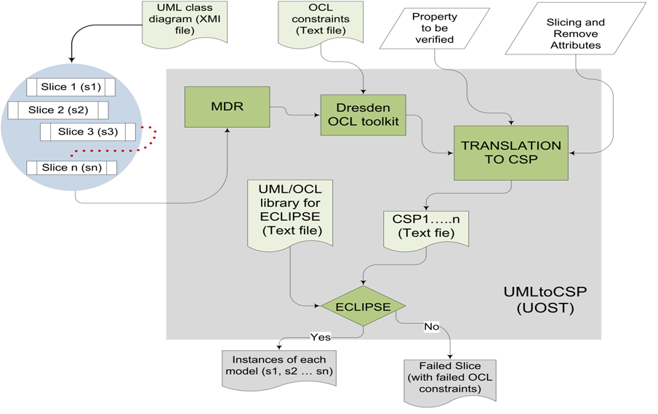
UMLtoCSP(UOST)
Solution

Slide 27
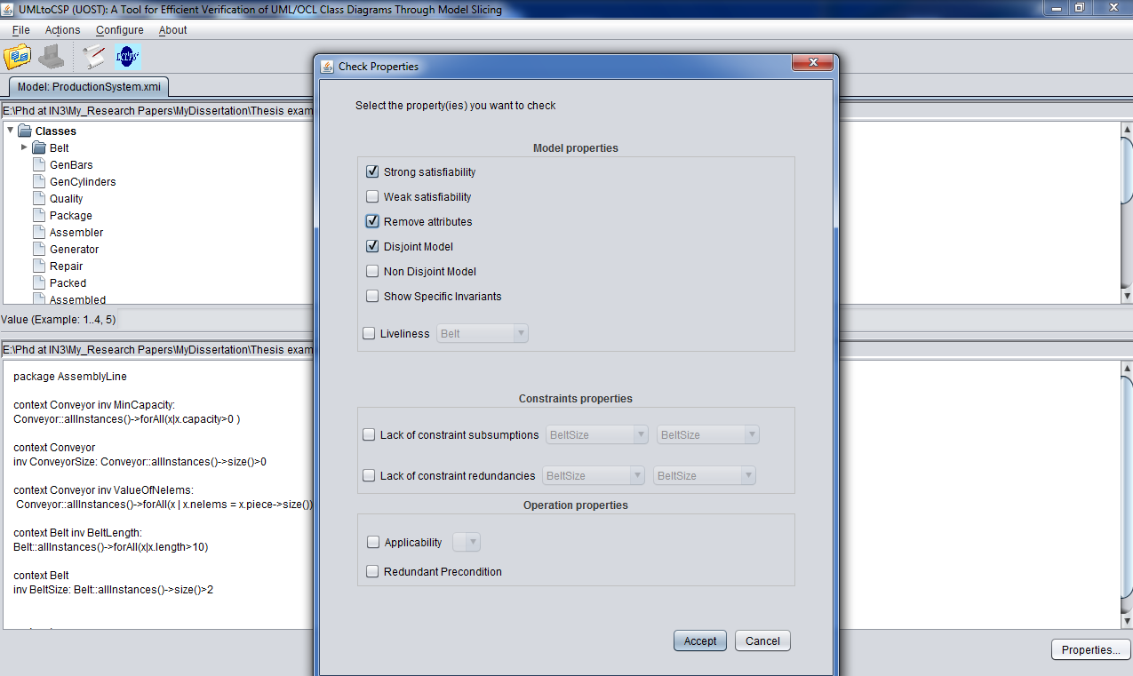
Disjoint Slicing (Demo)
Solution

Slide 28
Non-disjoint Slicing
Solution
Submodel 1
Submodel 2
context Conveyor inv MinCapacity:
self.capacity > 0
context Conveyor inv ValueOfNelems:
self.piece->size()=self.nelems
context Conveyor inv ConveyorSize: Conveyor::allInstances()->size()>0
context Belt inv BeltLength:
self.length>10
context Belt inv BeltSize:
Belt::allInstances()->size()>2

Slide 29
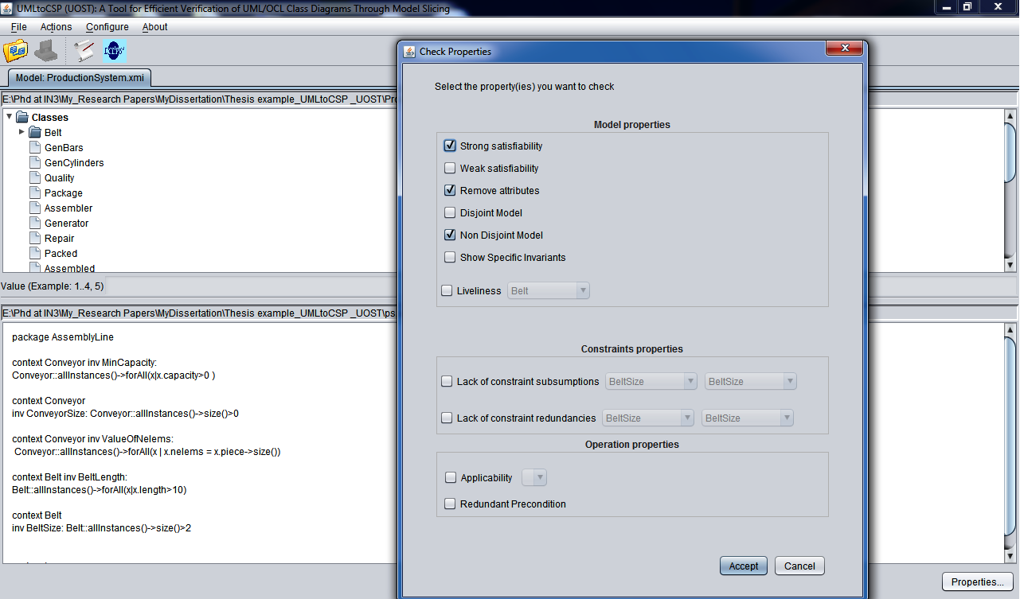
Non-disjoint Slicing (Demo)
Solution

Slide 30
The Feedback Technique
Solution
Unsatisfiable Submodel
Specific constraint(s)

Slide 31
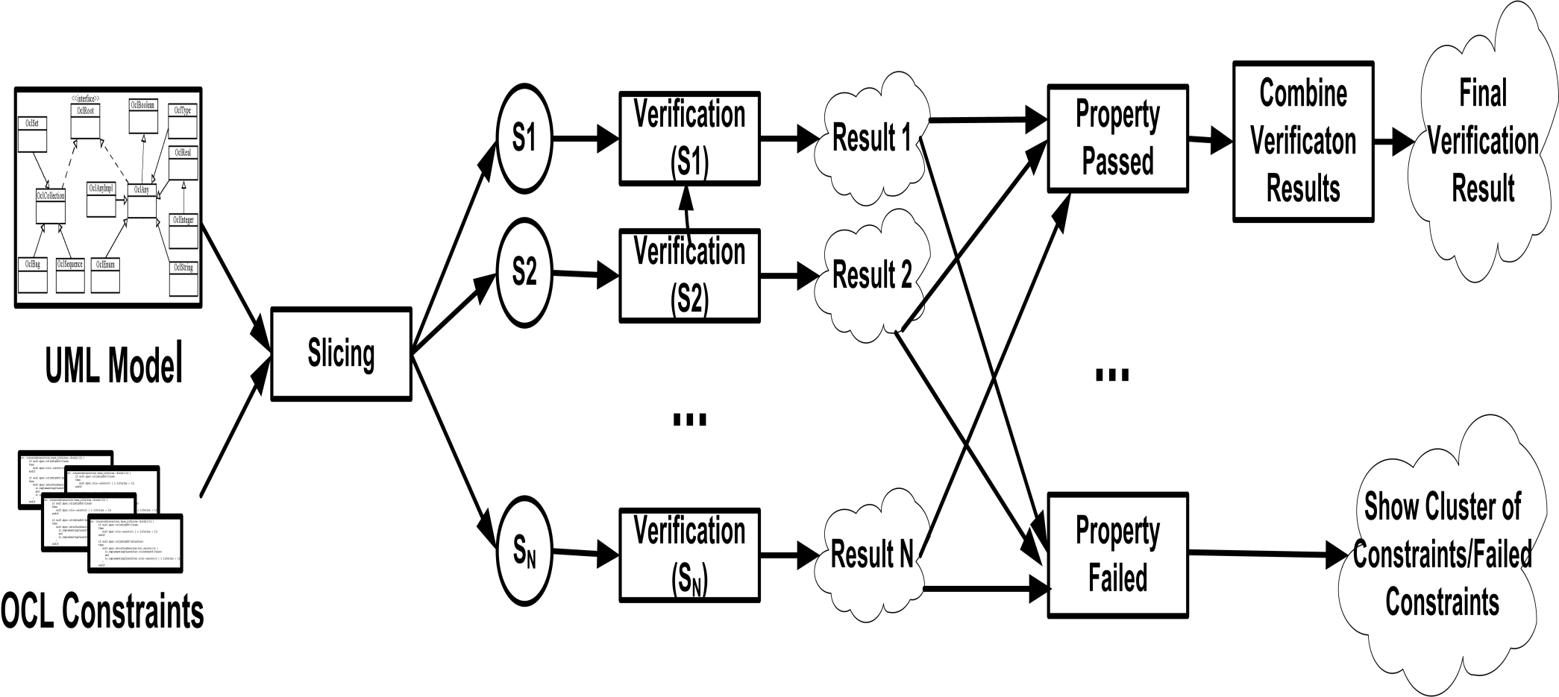
The Feedback Technique
Solution

Slide 32
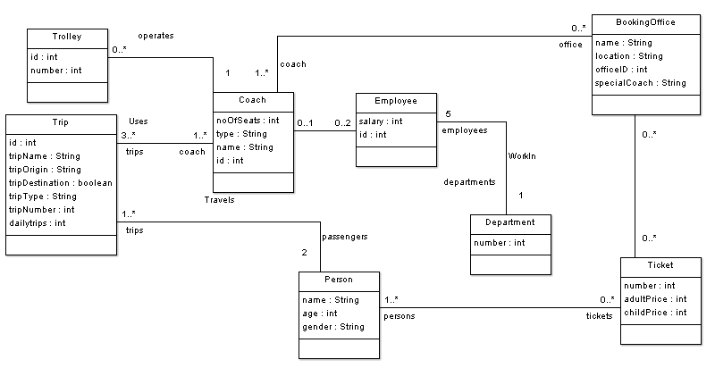
Model Coach (Feedback)
Solution

Slide 33
Model Coach (Feedback)
Solution
context Coach inv MinCoachSize:
Coach::allInstances()->forAll(a|a.noOfSeats>10)
context Person inv PersonSize:
Person::allInstances()->size()= 7
context Trip inv idUnique:
Trip::allInstances()->isUnique(a|a.id)
context Person inv PersonsTicket:
Person::allInstances()->isUnique (t|t.tickets.number)
context Department inv DeptartmentSize:
Department::allInstances()->size()= 1
context Employee inv EmployeeSize:
Employee::allInstances()->size()= 10

Slide 34
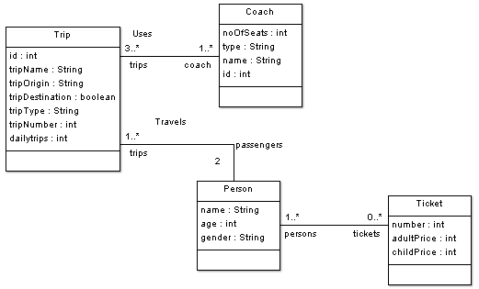
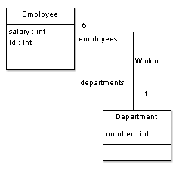
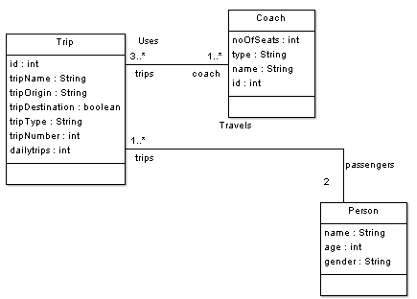
Submodels (Non-disjoint)
Solution
Submodel 1
Submodel 2
Submodel 3

Slide 35
Submodels (Non-disjoint)
Solution
Submodel 1
Submodel 2
context Department inv DeptartmentSize:
Department::allInstances()->size()= 1
context Employee inv EmployeeSize:
Employee::allInstances()->size()= 10
context Person inv PersonsTicket:
Person::allInstances()->isUnique (t|t.tickets.number)
context Coach inv MinCoachSize:
Coach::allInstances()->forAll(a|a.noOfSeats>10)
context Person inv PersonSize:
Person::allInstances()->size()= 7
context Trip inv idUnique:
Trip::allInstances()->isUnique(a|a.id)
Submodel 3

Slide 36
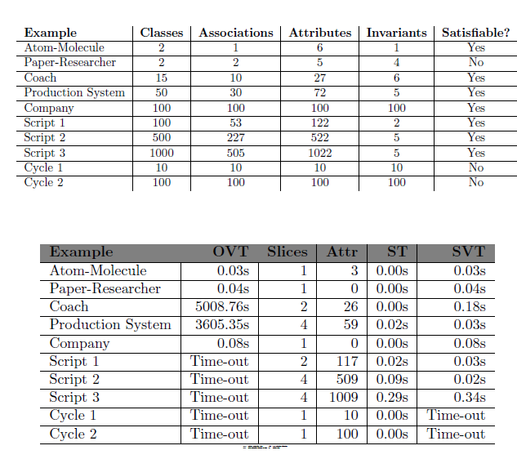
Results (UMLtoCSP)
Results

Slide 37
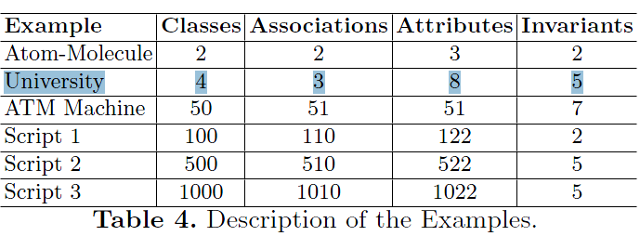
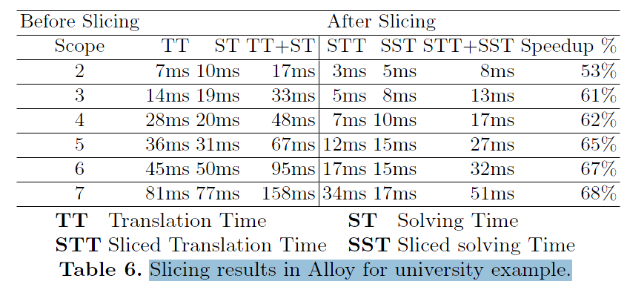
Results (Alloy)
Results

Slide 38
Publications
Conclusions
Asadullah Shaikh, Robert Clariso, Uffe Kock Wiil, and Nasrullah Memon. Verification-Driven Slicing of UML/OCL Models. In 25th IEEE/ACM International Conference on Automated Software Engineering, Antwerp, Belgium. Acceptance ratio: 18%, 10 citations
Asadullah Shaikh, Uffe Kock Wiil, and Nasrullah Memon. UOST: UML/OCL Aggressive Slicing Technique for Efficient Verification of Models. In System Analysis and Modelling (SAM 2010). LNCS. Acceptance ratio: 46%. 5 citations
Asadullah Shaikh, Uffe Kock Wiil, and Nasrullah Memon. Evaluation of Tools and Slicing Techniques for Efficient Verification of UML/OCL Class Diagrams. Advances in Software Engineering, Volume 2011 (2011). (H1,H2 and H3)

Slide 39
Publications
Conclusions
Asadullah Shaikh and Uffe Kock Wiil. UMLtoCSP (UOST): A Tool for Efficient Verification of UML/OCL Class Diagrams Through Model Slicing. In 20th International Symposium on Foundations of Software Engineering Cary, Acceptance ratio: 17%.
Asadullah Shaikh and Uffe Kock Wiil. Efficient Verification-Driven Slicing Technique for UML/OCL Models. Submitted to Transactions on Software Engineering and Methodology (TOSEM) by ACM. Impact Factor: 2.029.
Asadullah Shaikh and Uffe Kock Wiil. A Feedback Technique for Unsatisfiable UML/OCL Class Diagrams. Submitted to Software Practice and Experience (SPE) by Wiley. Impact Factor: 0.519.

Slide 40
Future Work
Conclusions
TransGenDoc.
More constructive feed back.
Deploy UMLtoCSP(UOST) in real world development scenarios.
Formalism with built-in slicing.
Notes:
We have received lot of motivation from reviewers to continue this line is research

Slide 41
Thank you!

